Slide 1
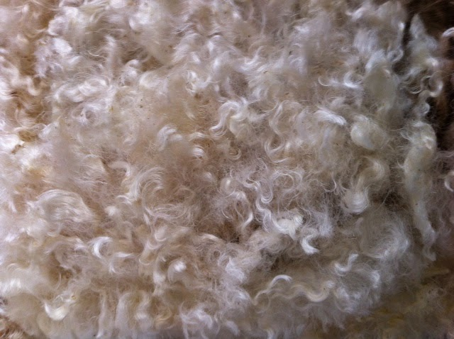
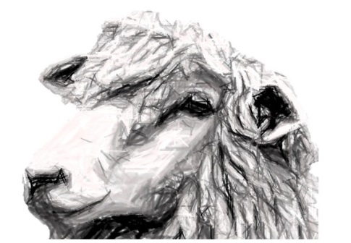
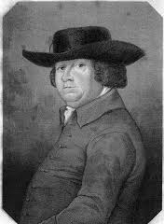
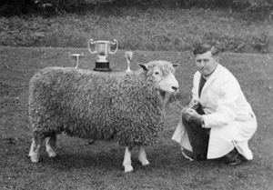
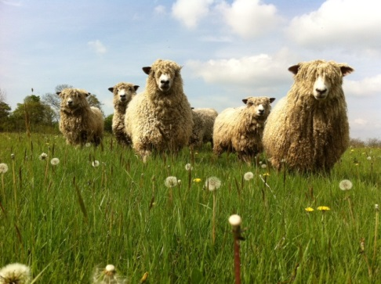
Loddington Longwools
Robert Bakewell the 18th century agricultural pioneer improved the Leicester sheep breed at Dishley Grange, Leicestershire.
1795- Leicester Longwools
were taken to Yorkshire for
their meat and wool.
1834 - The link between Leicester Longwool’s and the Speeton Flock began .
2014 – Five Speeton ewes return to Leicestershire and form the nucleus of the Loddington Longwool flock.

Slide 2
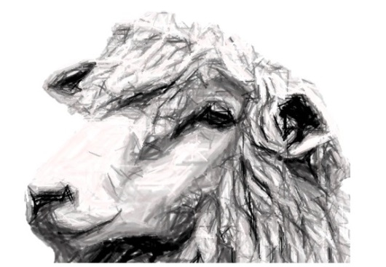
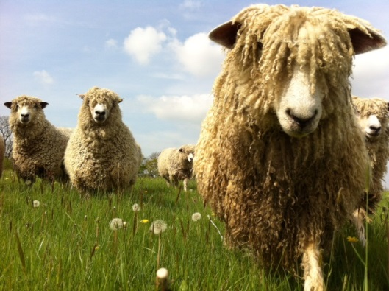
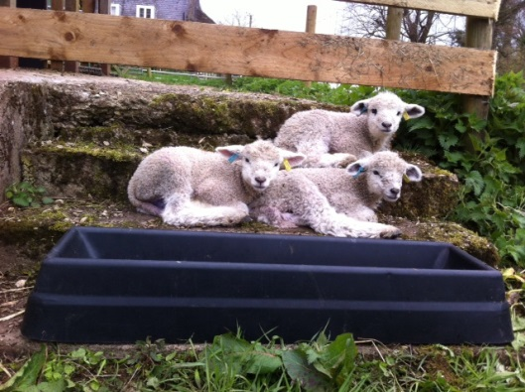
Loddington Longwools
Leicester Longwool Ewes
Leicester Longwool Ram
Leicester Longwool Lambs

